Slide 1



PYTHON PROGRAMMING COURSE
Python Development Essentials
Understanding pip • Environment Variables (.env Files) • File Handling in Python
PRESENTED BY
DATE OF SESSION
Muhammd Yousif Memon
June 2026

Slide 2

Learning Objectives
Understand the purpose of pip.
Install and manage external packages.
Secure configurations using .env files.
Read and write files persistently.
Apply these techniques in real-world projects.
Python Development Essentials | Package Management & File Handling

Slide 3
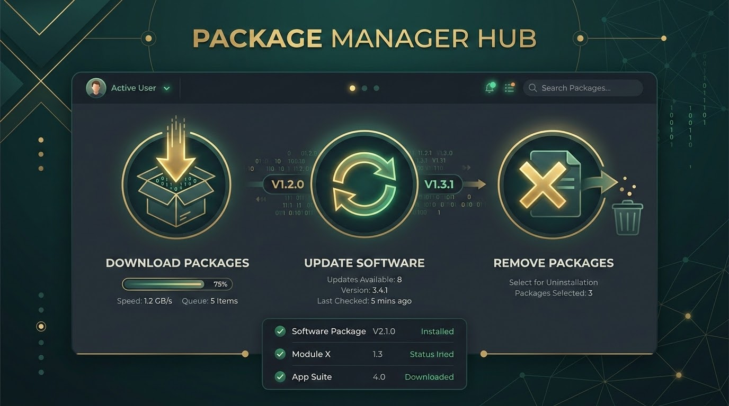
What is pip?
Acronym: Pip Installs Packages
Python's standard package manager, used to manage software libraries and dependencies.
CORE FUNCTIONS
Install: Download and set up new libraries
Upgrade: Update existing packages to latest versions
Remove: Uninstall unneeded project libraries
Manage: Control complex project dependencies
Python Development Essentials | Package Management & File Handling

Slide 4

Why Do We Need pip?
Bridging the gap between built-in capabilities and global innovation
THE LIMITATION
THE SOLUTION
Standard Library: Python's built-in modules are powerful but not exhaustive for all specialized needs.
PyPI Access: Instantly access thousands of third-party libraries via the Python Package Index.
POPULAR EXAMPLES:
Data Science: NumPy, Pandas
Web Development: Flask, Django
Machine Learning: TensorFlow
Python Development Essentials | Package Management & File Handling

Slide 5
Checking pip Installation
Verify that pip is installed and accessible in your environment.
TERMINAL COMMAND & OUTPUT
# Check the current version of pip
pip --version
# Example Output:
pip 25.1 from /usr/local/lib/python3.10/site-packages/pip (python 3.10)
Python Development Essentials | Package Management & File Handling

Slide 6

Installing Packages Using pip
Download and install external libraries directly from the Python Package Index.
Standard Syntax
pip install package_name
Practical Example
pip install pandas
Technical Infrastructure Context
Python Development Essentials | Package Management & File Handling

Slide 7
Installing Specific Package Versions
Locking versions ensures stability and reproducibility.
Command Example
pip install pandas==2.2.3
Key Benefits:
Stability: Prevents compatibility issues.
Predictability: Avoids unexpected breaking changes.
Reproducibility: Ensures consistent behavior across different machines.
Python Development Essentials | Package Management & File Handling

Slide 8

Upgrading Packages
Keep your libraries up to date with the latest features and security patches.
Standard Command
pip install --upgrade pandas
Shorthand Command
pip install -U pandas
Visualizing System Upgrade Logic
Python Development Essentials | Package Management & File Handling

Slide 9
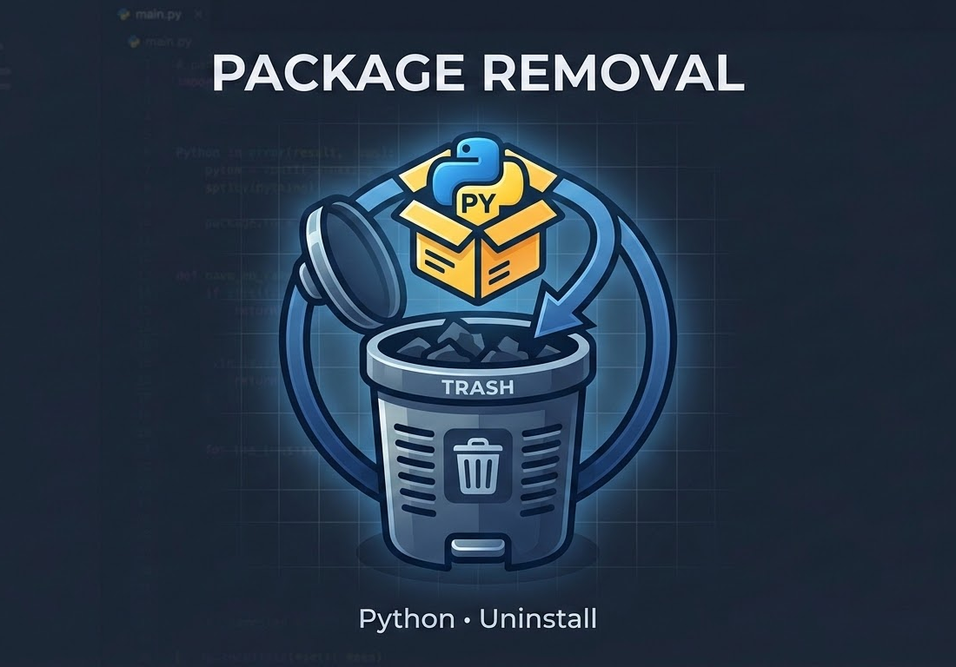
Uninstalling Packages
Remove unnecessary libraries to keep your environment clean.
COMMAND
pip uninstall pandas
PROCESS
Executes the removal request.
Requires user confirmation (Proceed (Y/n)?).
Deletes the package files.
Python Development Essentials | Package Management & File Handling

Slide 10
Viewing Installed Packages
Review all libraries currently active in your Python environment.
COMMAND
Package Names: Identifies all installed libraries.
pip list
Installed Versions: Shows specific version numbers.
Audit: Essential for managing project dependencies.
$ pip list
Package Version
-------------- -------
numpy 1.24.3
pandas 2.0.2
pip 23.1.2
requests 2.31.0
setuptools 67.8.0
Python Development Essentials | Package Management & File Handling

Slide 11
Package Information
Inspect detailed metadata for a specific installed package.
pip show pandas
# Output includes:
Name: pandas
Version: 2.2.2
Summary: Powerful data structures for data analysis...
Location: /usr/local/lib/python3.10/site-packages
Requires: numpy, python-dateutil, pytz
Required-by: seaborn, statsmodels
Version & Summary: Identifies the installed release and package purpose.
Dependencies (Requires): Packages needed for this tool to function.
Installation Location: The physical path where the package resides.
Reverse Deps (Required-by): Other packages that depend on this one.
Python Development Essentials | Package Management & File Handling

Slide 12

Requirements Files
Create a snapshot of your project's exact environment.
Standard Filename
requirements.txt
GENERATION COMMAND
pip freeze > requirements.txt
Purpose: Records all installed packages and their exact versions.
Python Development Essentials | Package Management & File Handling

Slide 13
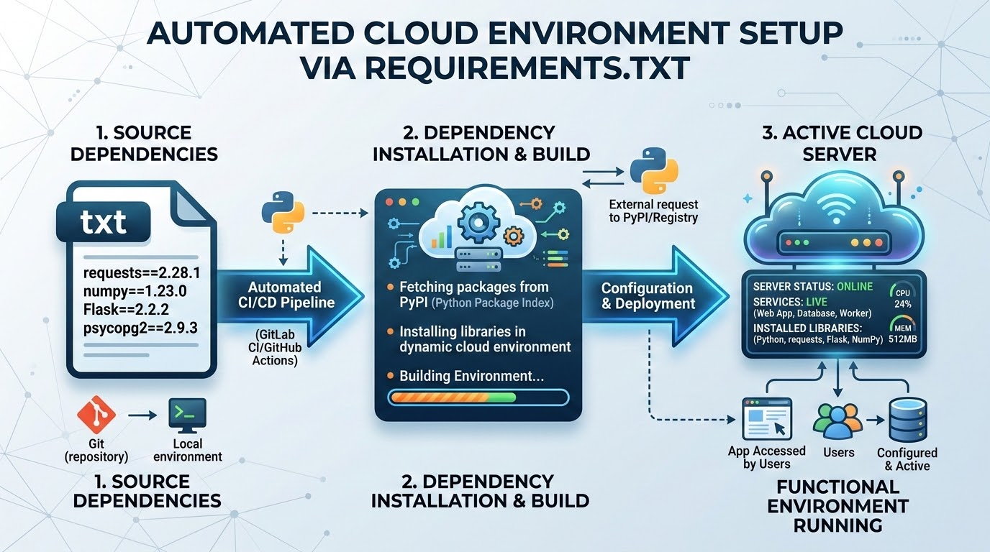
Installing from Requirements File
Replicate an environment instantly on a new machine.
Input File
requirements.txt
Command
pip install -r requirements.txt
Environment
Packages Installed Successfully
Key Benefits
Facilitates easy project sharing: Just send the code and the text file.
Guarantees consistent environments: Everyone uses the exact same versions.
Enables faster setup: New developers can start coding in minutes.
AUTOMATION IN ACTION
Dependency management is core to automated CI/CD pipelines.
Python Development Essentials | Package Management & File Handling

Slide 14
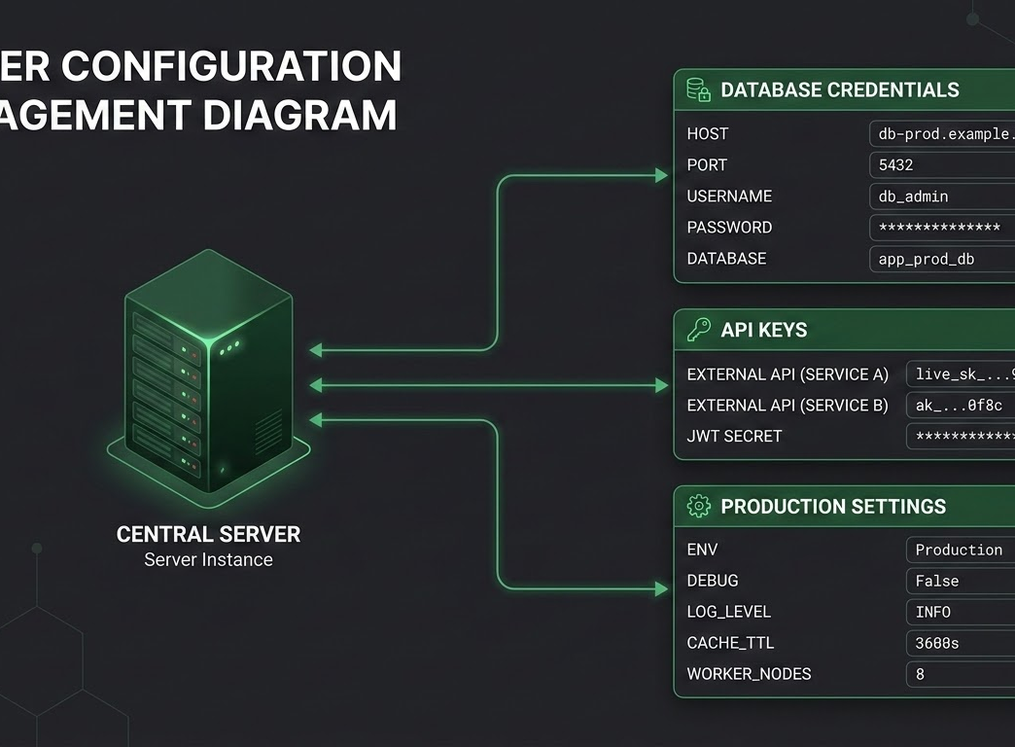
What are Environment Variables?
Definition
Dynamic configuration values stored outside the application's source code.
Common Examples:
Database credentials: host, user, password
API keys: Service access and authentication keys
Security tokens: JWT secrets and sensitive identifiers
Environment toggles: Development vs. Production states
Server Configuration Overview
Python Development Essentials | Package Management & File Handling

Slide 15

Why Use .env Files?
Protect your sensitive data and increase flexibility.
The Problem
The Solution
Hardcoding Secrets
Keep Secrets Separate
Hardcoding secrets (e.g., api_key = "123456") is a massive security risk.
Keep secrets separate from the source code using .env files.
Result: Prevents accidental uploads of passwords to version control systems like GitHub.
api_key = "123456" # UNSAFE
Python Development Essentials | Package Management & File Handling

Slide 16
Creating a .env File
DEFINITION
A simple, hidden text file stored at the root of your project.
FORMATTING RULES
Name the file exactly .env • Use KEY=VALUE format • No spaces around the equals sign
# Example .env file entries
API_KEY=987654321xyz
DB_HOST=localhost
DB_USER=admin
DB_PASSWORD=supersecret
Python Development Essentials | Package Management & File Handling

Slide 17

Installing python-dotenv
The standard library for connecting .env files to your Python script.
INSTALLATION COMMAND
pip install python-dotenv
PURPOSE
Automatically reads the .env file and loads key-value pairs into the OS environment variables.
Visual representation of .env integration within the Python ecosystem.
Python Development Essentials | Package Management & File Handling

Slide 18
Reading .env Variables
Accessing your secure configurations within your Python code.
EXAMPLE CODE
import os
from dotenv import load_dotenv
# Load variables from .env
load_dotenv()
# Retrieve the value
api_key = os.getenv("API_KEY")
print(api_key)
Python Development Essentials | Package Management & File Handling

Slide 19
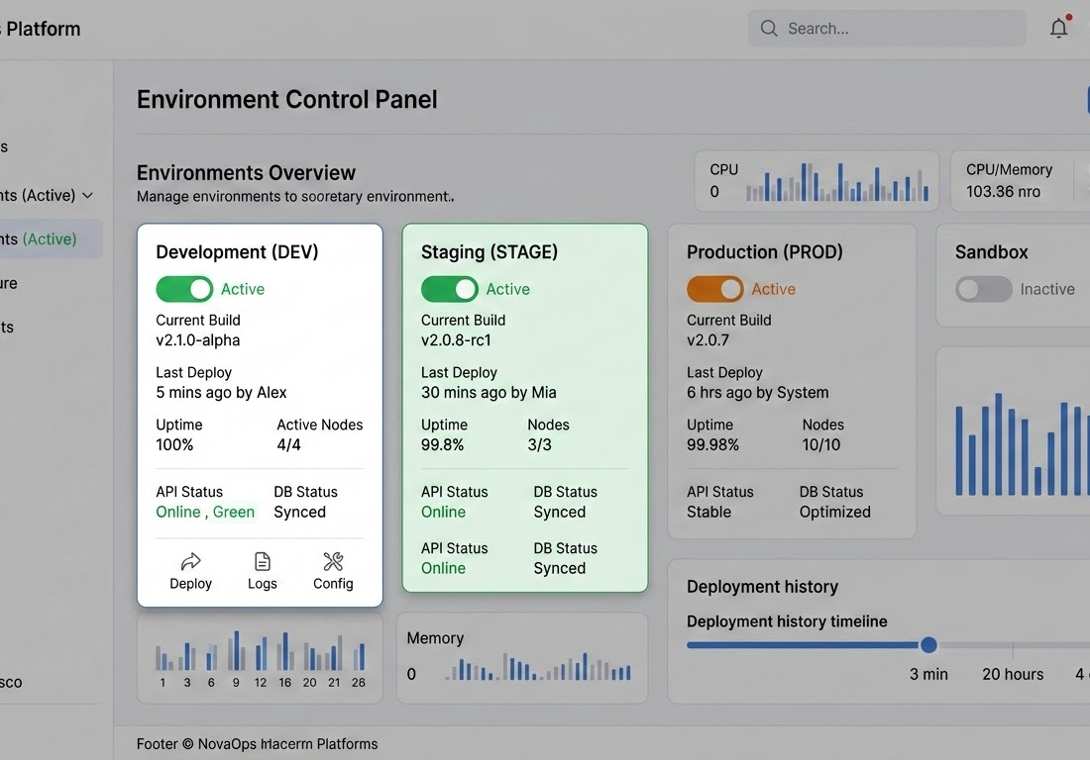
Benefits of .env Files
Security: Sensitive data kept out of version control.
Cleaner Code: Configuration separated from logic.
Environment Switching: Easily swap between Dev, Testing, and Production settings.
Deployment: Aligns with modern cloud standards.
Environment Control Panel Illustration
Python Development Essentials | Package Management & File Handling

Slide 20

Introduction to File Handling
Managing persistent data within Python applications.
Core Capabilities
Store data permanently
Read existing information
Create automated reports
Process text and logs
"Persistence is the ability of data to outlive the execution of the program that created it."
Python Development Essentials | Package Management & File Handling

Slide 21
Opening Files
Use the built-in open() function to interact with files.
SYNTAX
file = open("sample.txt", "r")
PRIMARY MODES
MODE
DESCRIPTION
"r"
Read (Default Mode)
"w"
Write (Overwrites existing content)
"a"
Append (Adds to the end of the file)
"x"
Create (Creates new file; fails if exists)
Python Development Essentials | Package Management & File Handling

Slide 22
Reading Files
Extracting data from an opened text file.
file = open("sample.txt", "r")
content = file.read()
print(content)
file.close()
KEY NOTE
Always remember to close() the file to free system resources.
Python Development Essentials | Package Management & File Handling

Slide 23
Writing and Appending Files
File Handling Modes in Python
Write Mode ("w"): Overwrites existing content.
Append Mode ("a"): Adds to existing content.
file = open("data.txt", "w")
file.write("New content\n")
file.close()
# Creates new file or clears existing
file = open("data.txt", "a")
file.write("Additional line\n")
file.close()
# Keeps existing data; adds at end
Python Development Essentials | Package Management & File Handling

Slide 24

Using the with Statement
EXAMPLE CODE
KEY BENEFITS
The recommended, Pythonic approach to file handling.
Automatic Closure: Ensures file is closed even if errors occur.
Cleaner Syntax: Reduces boilerplate and nested logic.
with open("sample.txt", "r") as file:
content = file.read()
print(content)
# File is automatically closed here
Memory Efficiency: Prevents memory leaks from unclosed handlers.
Python Development Essentials | Package Management & File Handling

Slide 25

Summary and Best Practices
PACKAGE MANAGEMENT
SECURITY & CONFIG
DATA INTEGRITY
pip: Track packages using requirements.txt.
.env Files: Never hardcode secrets. Use python-dotenv.
File Handling: Prefer the with statement for safe operations.
KEY TAKEAWAY
Modern Python projects rely on secure configuration, robust dependency management, and persistent data handling.
Python Development Essentials | Package Management & File Handling

